Slide 1
Day 2: Understanding challenges to reproducibility
David Souto
School of Psychology and Vision Sciences

Slide 2
What are challenges to reproducibility?
QRPs
P-values misconceptions
Power

Slide 3
Session 1: P-values and forking paths

Slide 4
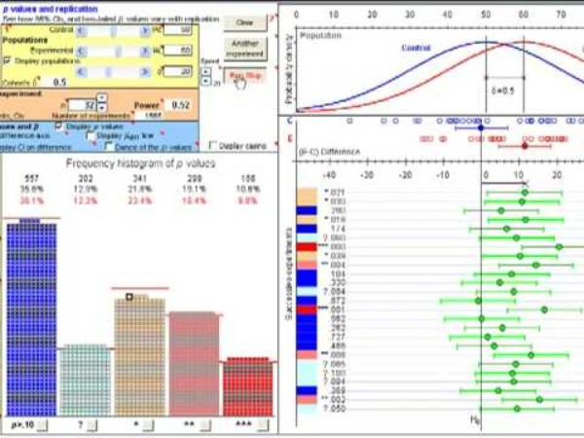
Dance of the p-values (10’)
Notes:
Geoff Cumming made his argument very eloquently in this video, why not watch it

Slide 5
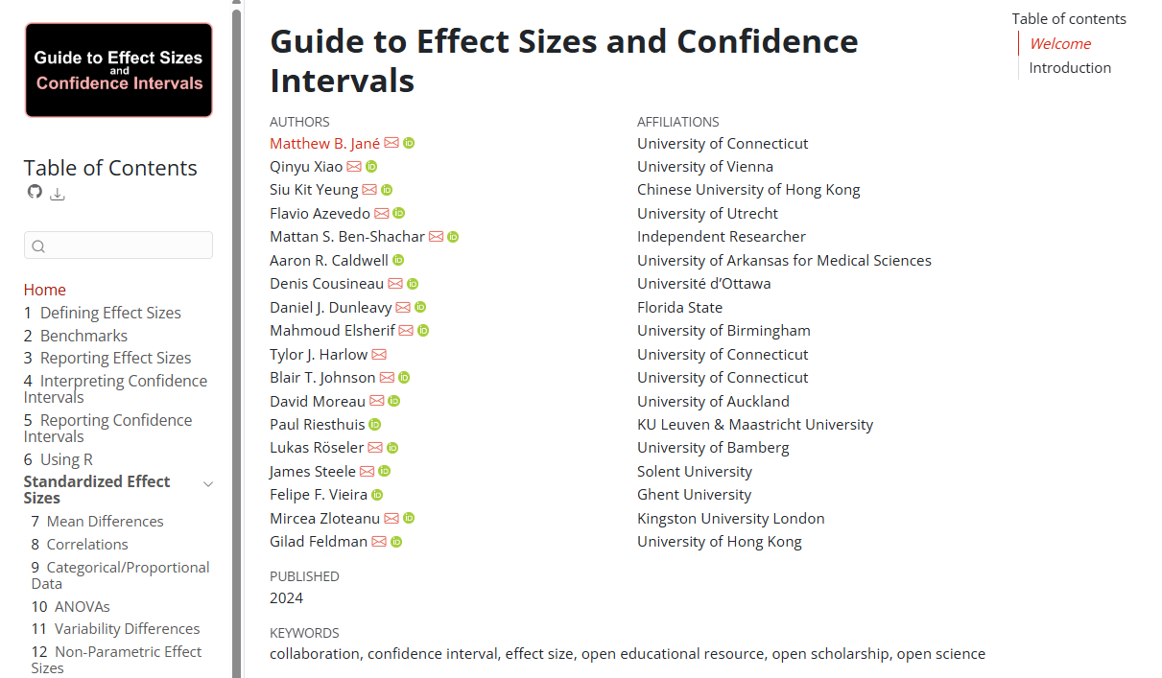
Confidence & effect size
Move to reporting confidence around effect sizes rather than p-values
With
R code
“The treatment group had a significantly higher mean than the control group (t = 2.76, p = .009, n = 35, d = 0.47, 95% CI [0.11, 0.81]).”
https://matthewbjane.quarto.pub/

Slide 6
Session 1 Worksheets

Slide 7
Session 2: Power and sample selection

Slide 8
Familiar scenario #2
You do a bunch of tests. Among all your hypothesis something comes out as p >.02.
You try to publish but get desk rejected in the most reputable journal.
Desk rejection indicates you tested 5 hypothesis and the likelihood of one of them crossing the threshold is very high (see Maxwell, 2004) and the rational for which ones should be significant is not very compelling.
Notes:
Instead you preregister, simplify design to get more power, pick your contrasts instead of going for the omnibus anova.

Slide 9

How do we justify our samples?
Notes:
We should become experts in this, as this is often hard and we need to have a good understanding of it to argue our case. If we test hypothesis we need to be able to justify our samples. Every field has its difficulties with this. As argued in the paper, simulation can sometimes be the easy way, while also allowing your to think deeper about the data you are collecting.

Slide 10
Low power and replicability
Desk reject from Affective Sciences
“A key concern, however, is the quite small sample size. Although a power analysis is provided, no justification is given for the anticipated "medium" effect size, and the study does not appear to have been preregistered. Although small sample sizes may provide ample power to reject the null hypothesis in within-between interactions, they still suffer from problems with effect size estimation and generalizability.“
Notes:
Probably something we need to get familiar with. The fact an effect is statistically significant is not enough in itself!

Slide 11
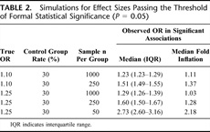
Low power
By definition: low probability of finding effect that exists
Low power and effect size: detected effects (p>.05), tend to have (at times “hugely”) inflated effect sizes
Low power and generalizability (post-study probability the reported finding is true, PPV): as power decreases, the probability that a statistically significant result represents a true effect decreases.
Lazic SE. Four simple ways to increase power without increasing the sample size. Laboratory Animals. 2018;52(6):621-629. doi:10.1177/0023677218767478
Ioannidis JPA (2005) Why Most Published Research Findings Are False. PLOS Medicine 2(8): e124. https://doi.org/10.1371/journal.pmed.0020124
Ioannidis, John P. A.. Why Most Discovered True Associations Are Inflated. Epidemiology: September 2008 - Volume 19 - Issue 5 - p 640-648 doi: 10.1097/EDE.0b013e31818131e7
Notes:
Ioannides (2008)
“Effect sizes of newly discovered true (non-null) associations are inherently inflated on average. This is due to the key characteristic of the discovery process. Inflation is expected when, to claim success (discovery), an association has to pass a certain threshold of statistical significance, and the study that leads to the discovery has suboptimal power to make the discovery at the requested threshold of statistical significance. Both conditions are necessary to inflate effect sizes. If investigators were not fixated on claiming discoveries based on P value thresholds, this would not be an issue. Similarly if the discovery studies were fully powered, inflation would not be an issue. Selection usually entails P values, but a similar pattern may be seen if selection is based on effect size or some other threshold measure.”
“For illustrative purposes, I use here a simulation approach to demonstrate this phenomenon and the relationship between inflation and lack of power. Suppose that the true odds ratio (OR) for an association is 1.10 or 1.25 and that the proportion of exposed individuals in the control group is 30%. We can simulate a set of studies that have an equal number of participants (n) in each of the 2 compared groups. The number of exposed in the control group in each simulated study is drawn randomly from a binomial distribution with probability 0.30. The number of exposed in the case group in each simulated study is drawn randomly from a binomial distribution with probability 0.3203 or 0.3488, so as to correspond to OR = 1.10 and 1.25, respectively. The median OR of these simulated studies is expected to be 1.10 or 1.25, respectively. However, this is not so when we focus only on the simulated studies that have a P value for the association crossing a specific level of statistical significance. Table 2 shows the median and IQR of the ORs that cross the “P value = 0.05” threshold of statistical significance for different values of n. As shown, even though the true OR is 1.10, the median observed OR when a study discovers this association (P < 0.05) is 1.51 when n = 250 (a study of 500 participants total). With similar sample sizes, when the true OR = 1.25, the discovered median OR is 1.60. When the studies have n = 50 (100 participants total), the median discovered OR is 2.73 instead of 1.25, representing huge inflation. One should note also the skewed nature of the distributions of discovered effects.”

Slide 12
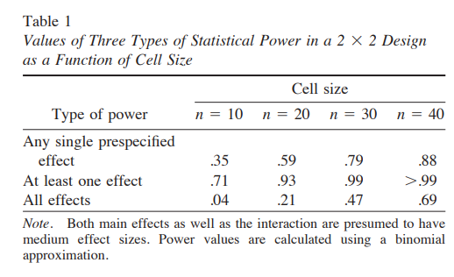
We test too many effects
Maxwell SE. The persistence of underpowered studies in psychological research: Causes, consequences, and remedies. Psychol Methods 2004; 9: 147–163.
Maxwell (2004)

Slide 13
Increase power without increasing sample size?
Appropriate analysis
Appropriate design
Focused hypothesis
… Almost as if pre-registration would help.
Notes:
Probably something we need to get familiar with. The fact an effect is statistically significant is not enough in itself!
Brysbaert: “Brysbaert and Stevens (2018) showed how a mere 16 ms priming effect (dav = .08) can be turned into a large effect size (dz = .9) when 210 words are presented per condition. Similarly, Zwaan et al. (2018) showed that several effects in cognitive psychology have effect sizes of dz > .5 when based on multiple observations per condition. So, another way to increase the power of the design is not to increase the number of participants but the number of observations per cell of the design (see also Rouder & Haaf, 2018).”
Look at reliability to see whether you can benefit from adding more observations:
The R package psychometric by Fletcher (2015) contains commands to calculate the two intraclass correlations of Shrout and Fleiss (1979). All you have to do is to import the full Table ​Table55 (long notation) in R and use the following commands:
library(psychometric)
ICC1.lme(Response, Participant, data=Table5)
ICC2.lme(Response, Participant, data=Table5)
…

Slide 14
Session 2 worksheets

Slide 15
Session 3: Strength of evidence and sample selection

Slide 16
Session 3 worksheets

Slide 17
Sequential testing with Bayes Factors

Slide 18
Sequential testing with NHST

Slide 19
Alpha spending functions
O'Brien-Fleming when early stopping is less critical
Pocock when all interim analyses are equally important
Haybittle-Peto for very conservative interim analyses

Slide 20
Plan interim analysis
Efficacy boundary
Futility boundary

Slide 21
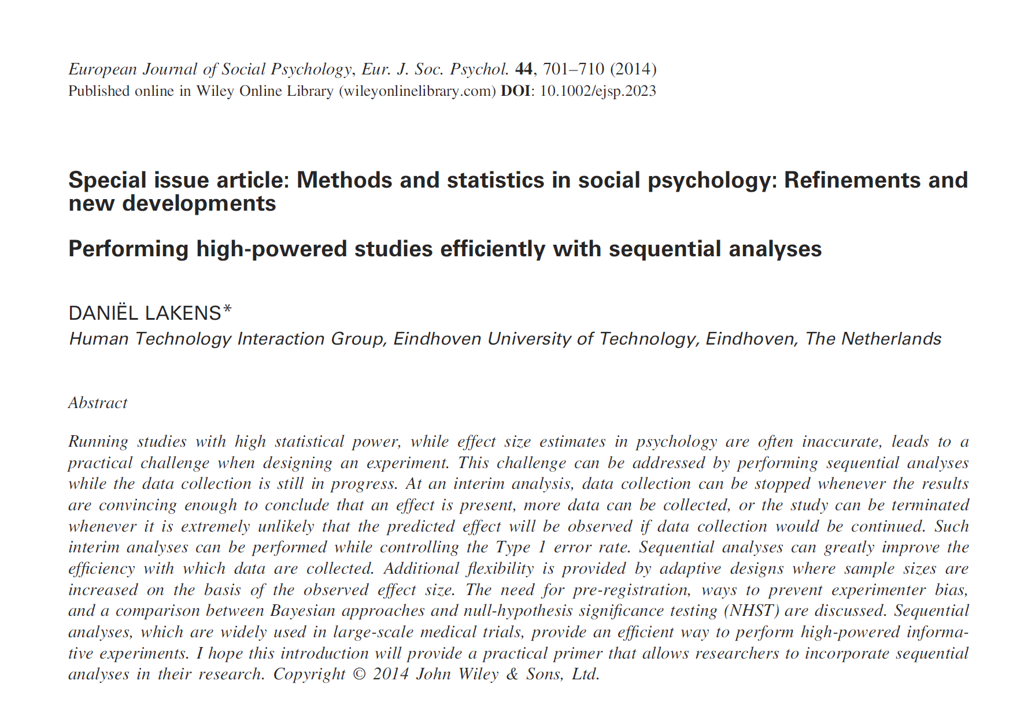
Accessible reference

Slide 22
Report Transparently
Example from Paper

